Slide 1
IOT Edge

Slide 2
Agenda
IOT & IOT Edge Introduction
Typical IOT Stack
IOT Protocols Overview
Application level IOT protocols details
MQTT
OPCUA
Introduction to existing projects-
EdgeX
Fledge
KubeEdge
eKuiper
EdgeGallery IOT Profile

Slide 3
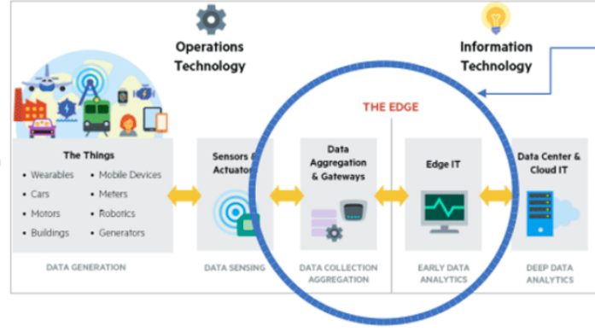
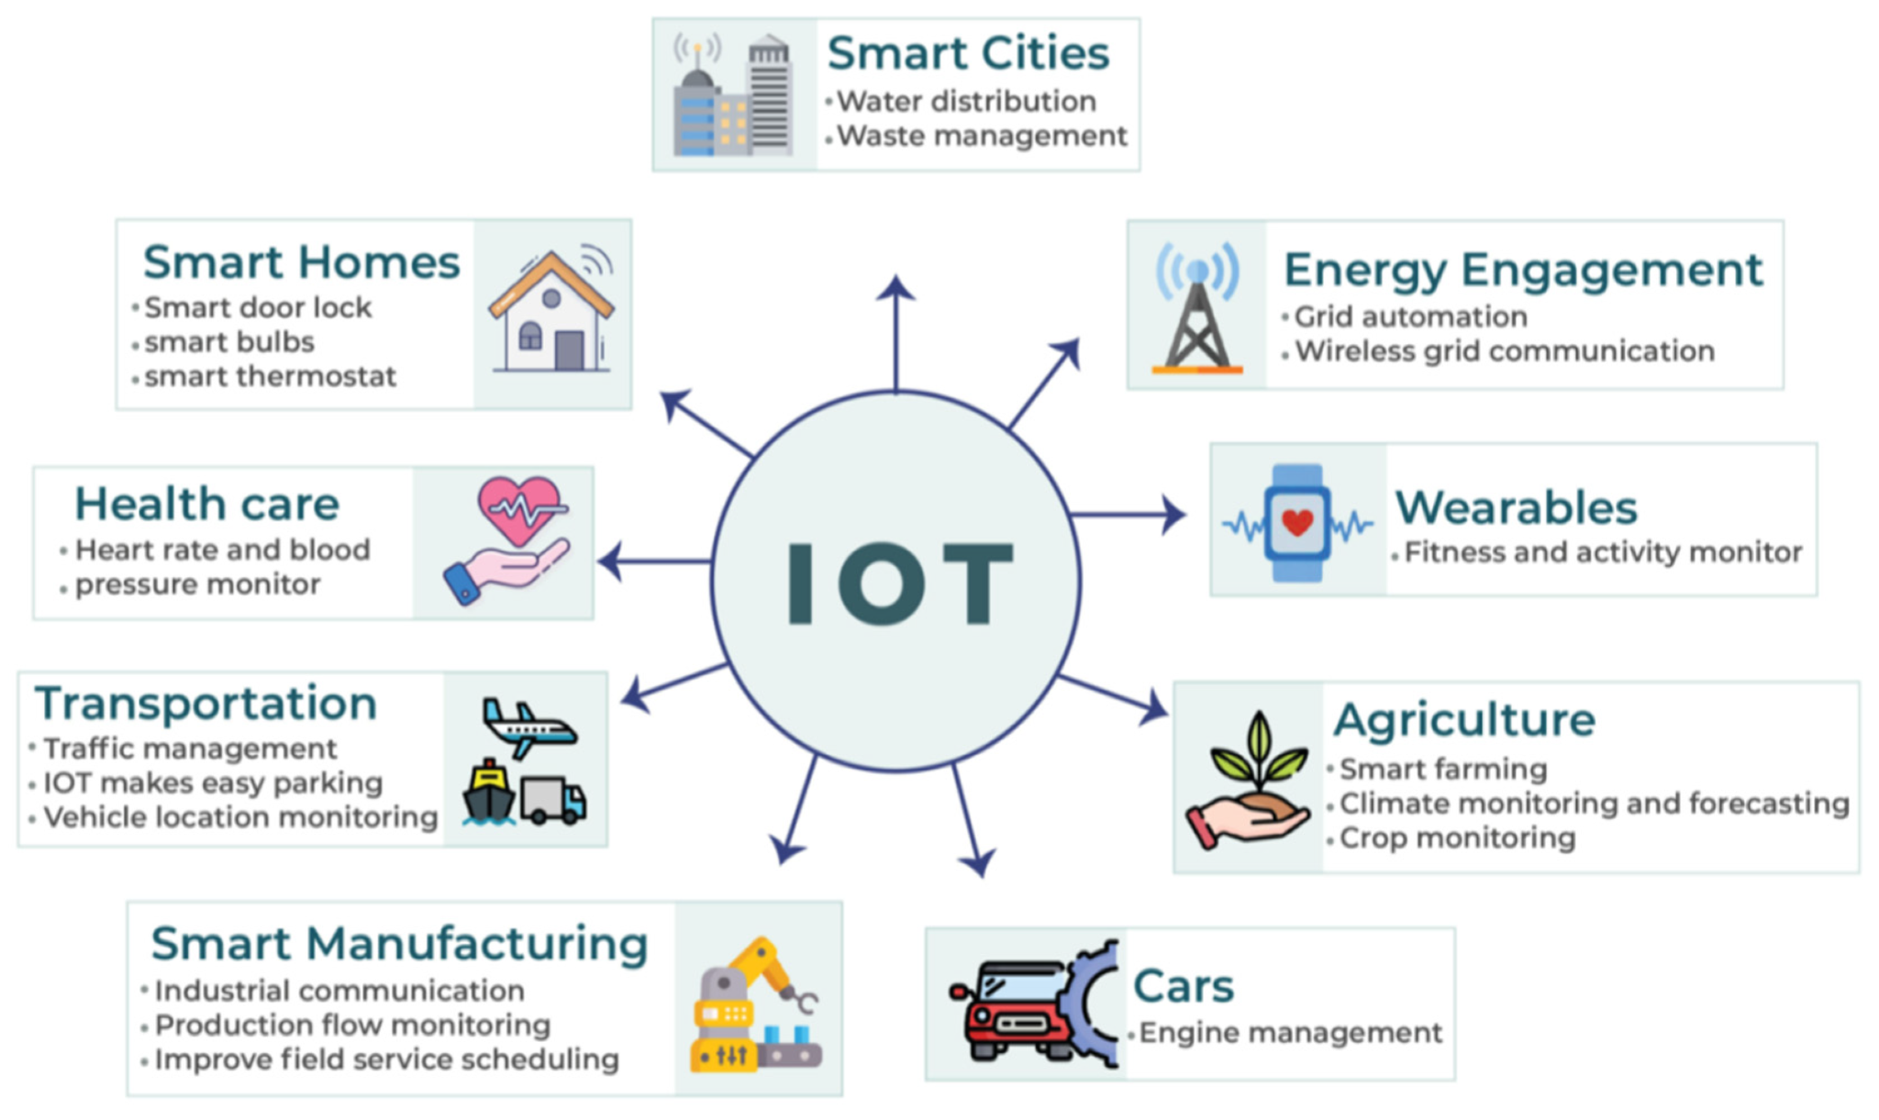
IOT Introduction
IOT Deployment
The Internet of Things (IoT) describes physical objects (devices) with sensors/actuators, processing ability, softwares that connect and exchange data with other devices and systems over the Internet or other communications networks.
Using IOT, can monitor and control the machines to enable automation without human interventions which enables use cases like smart factories, smart cities, home automation.
IOT can communicate over networks without human interactions. For this reason, a PC isn't generally considered an IoT device and neither is a smartphone.
Sensors: Sensors read and report on the real-world status of connected products, machines, and local environments. They are the eyes and ears of the system, monitoring environmental elements like temperature, light, and moisture
Actuators: They usually affect the electromechanical or logical state of a product or environment. They are the system’s hands and feet.
This enable close loop control of devices/machines without human interventions.
Use cases are like Home automation, smart factories, Robot, M2M, predictive maintenance etc.
IOT Usecases
Notes:
https://www.iotcentral.io/blog/the-iot-architecture-at-the-edge

Slide 4
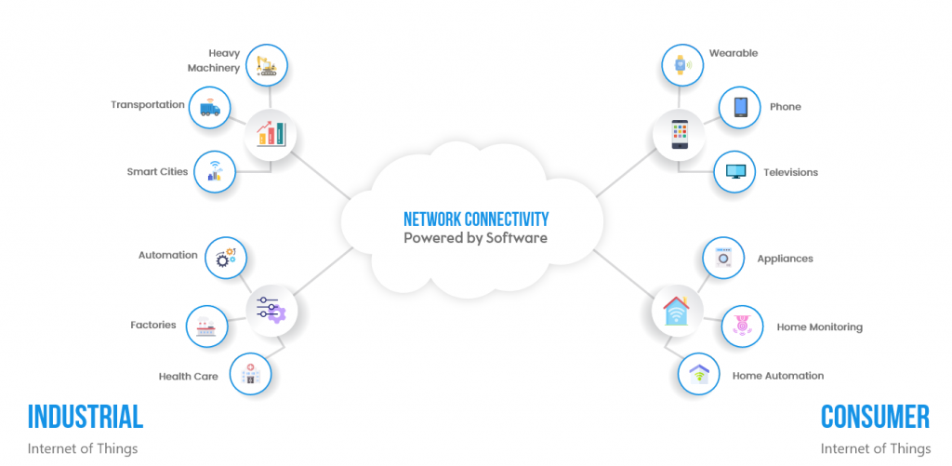
IOT Introduction: Type

Slide 5
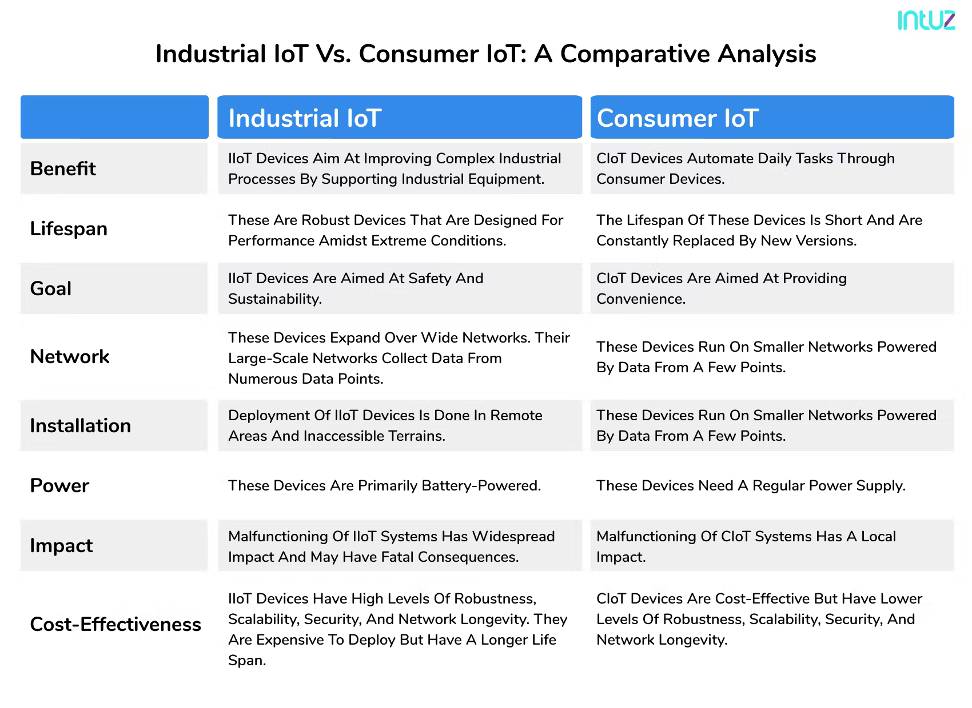
IOT Introduction: Type

Slide 6
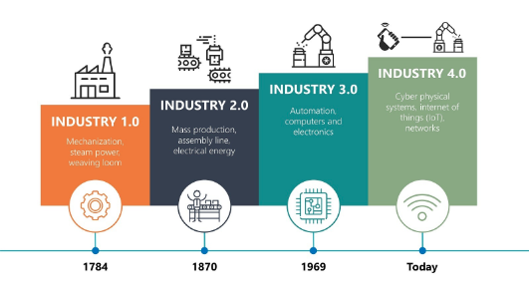
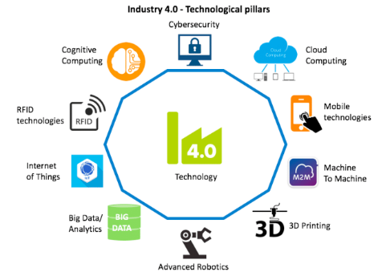
IIOT Driver: Industrial Rev. 4.0
What is Industrial Rev. 4.0:
Fourth Industrial Revolution is the trend towards automation of traditional manufacturing and data exchange in manufacturing technologies and processes by using modern smart technology.
Some of the emerging fields in the fourth industrial revolution include IoT, robotics, machine learning, artificial intelligence (AI), Cloud computing, Big data, 3D printing, M2M, Analytics etc.
Why:
Improve product quality, boost factory efficiency, enhance safety, security and sustainability, and remain profitable.
Why IOT:
IoT enable everything to be connected within a common network and the operations are mostly automated. Thus eliminating the need for much human intervention.
Real-time data monitoring improves the decision-making process, and predictability helps reduce the chances of future hazards in the industry.

Slide 7
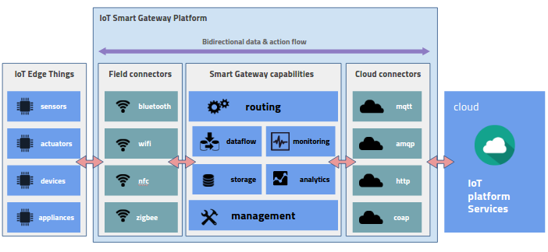
Why Edge for IIOT
For IIOT solutions, data processing at Central computing has issues like slow response(high latency), local data privacy, high bandwidth, security as enterprise data traveling all over internet.
IOT Edge computing is a local place of computing and storage for the data. IOT devices data in factory/enterprises need to be collected and processed for further insights and apply action in case close loop.
Some of Benefits of IOT edge:
Reduced latency of communication between IoT devices and IT networks.
Faster response times and increased operational efficiency.
Improved network bandwidth.
Continued systems operation offline when a network connection is lost.
Local data processing, aggregation, and rapid decision making via analytics algorithms and machine learning.

Slide 8
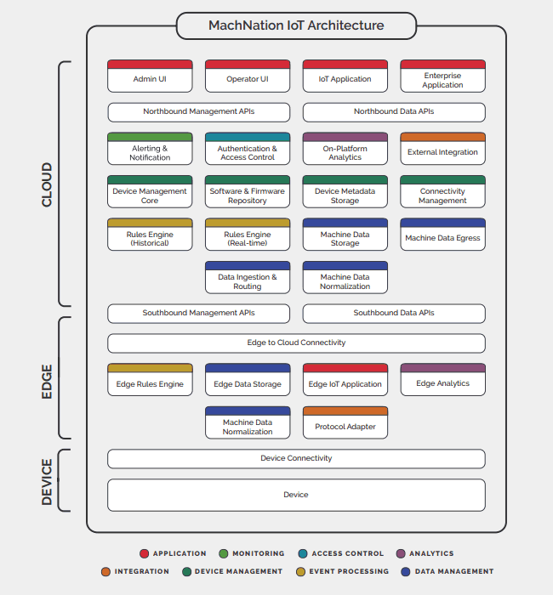
IIOT Edge requirements
Data filter: On IOT Edge, raw data from devices need to be filter(rules) to reduce BW consumption. For example, if temperature is more than threshold, only then send to cloud for action.
Data Transform(Normalize): to a meaningful units together(to provide overall health of a machine etc.) so that it can be consumed by end application in local data centers and central clouds
Protocol adapters: to communicate with southbound different IOT devices.
Storage: for offline edge support, data need to be stored on edges in case of network not available or need local processing on history data.
Cloud connector: to connect, control and sync data securely to cloud.
Edge Analytics: to get quick insight from real time data and take close loop control action quickly.
Device Twin: Digital replica of physical devices including current state of device
Security: Device and data security, including authentication of devices and confidentiality and integrity of data.

Slide 9
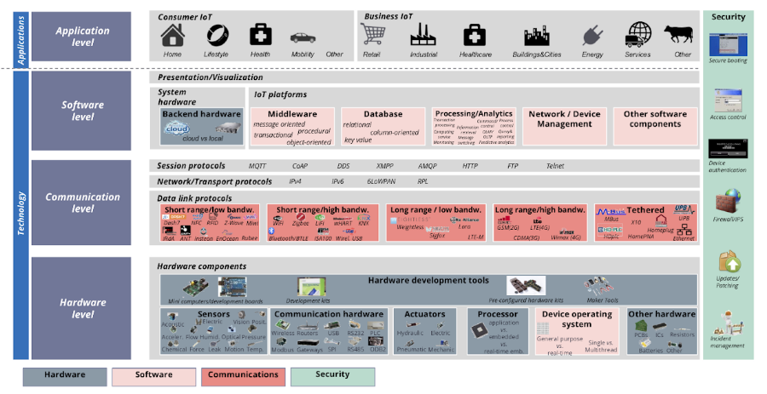
Typical IOT Stack Overview

Slide 10
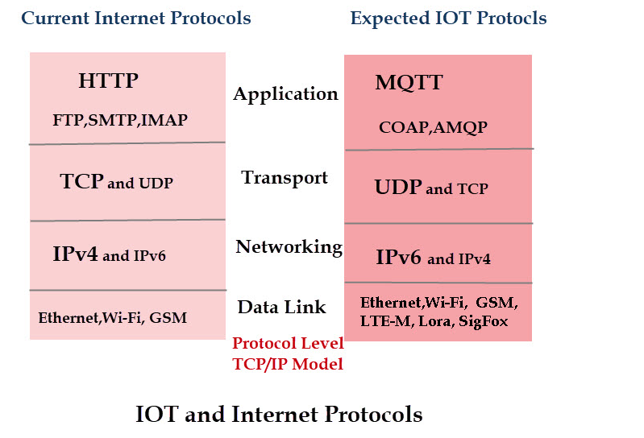
IOT Protocols Introduction
The areas that are showing the greatest activity are the datalink (levels 1 and 2) and application layer (level 4).
The network and transport layers protocols are same but dominated protocol is different.

Slide 11
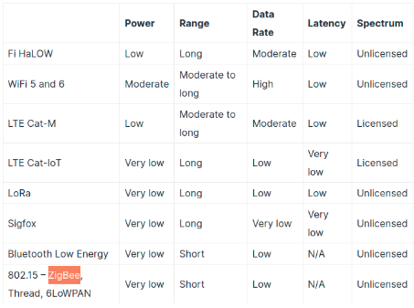
IOT Protocols Introduction - Data Link Level Protocols
Requirement to connect devices that are nearby e.g. on Local networks, and that are more distant wide area networks. Current computer networks use Ethernet and Wi-Fi at this level for home/office networking (LANs) and 3G/4G for Mobile connections (WANs).
However many IOT devices, like sensors, will be low powered (battery only). Ethernet isn’t suitable for these applications but low powered W-fi and low powered Bluetooth are.
Although existing wireless technologies (Wi-Fi, Bluetooth,3G/4G) will be used to connect these devices, other newer wireless technology, especially designed for IOT applications, will also need to be considered, and will likely grow in importance.
Among these are:
BLE (Bluetooth Low Energy) - Compared to Bluetooth, BLE is intended to provide considerably reduced power consumption and cost while maintaining a similar communication range (low power short range).
ZigBee: Low power, short range
LoRaWAN(long range wide area network) - LoRaWAN is a low-power, wide area networking protocol built on top of the LoRa radio modulation technique.
SigFox - utilizes a wide-reaching signal that passes freely through solid objects, called "Ultra Narrowband" and requires little energy, being termed a "low-power wide-area network" (LPWAN)
NB-IOT - low-power wide-area network (LPWAN) radio technology standard developed by 3GPP for cellular devices and services.
IOT Wireless technology comparison
Notes:
Device type and use case ??
https://www.iotforall.com/wifi-role-iot

Slide 12
IOT Protocols Introduction - Networking and transport Level
Network:
As there are supposed to be high number of IOT devices. The protocol that is set to dominate at the networking level in the long term is IPv6.
It is very unlikely that IPv4 will be used, but it may play a role in the initial stages. For example, most Home IOT devices e.g smart lights currently use IPv4.
Transport:
Because of the requirement for low protocol overhead It would expect UDP to feature much more in the future IOTs

Slide 13
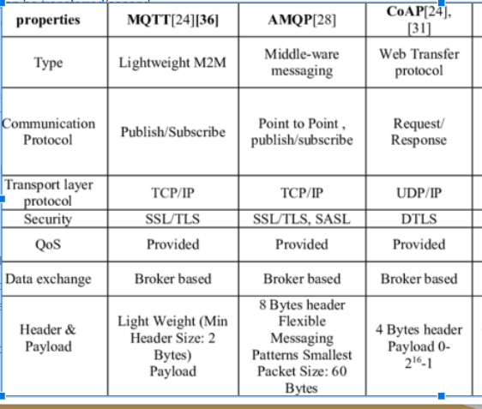
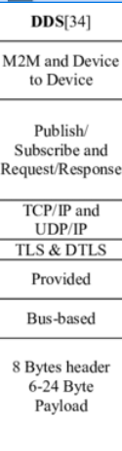
IOT Protocols Introduction - Application Level Protocols
Important Characteristics for Application level IOT Protocols
Speed – Amount of data that can be transferred/second
Latency – amount of time a message takes to be transferred
Power consumption
Security
HTTP which is main application protocol for web services is not suitable for IOT because of the high protocol overhead.
MQTT (Message Queuing Telemetry Transport) has emerged as the main IOT messaging protocol because it is lightweight and easy to use.
Other Application level protocols:
AMQP -( Advanced Message Queuing Protocol) Uses TCP/IP. Publish subscribe model and Point to Point .
COAP-(Constrained Application Protocol) -Uses UDP designed specifically for IOT uses request response model like HTTP. RFC 7252
DDS– Data Distribution Service

Slide 14
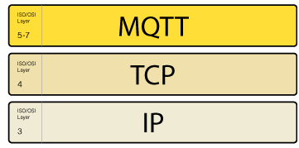
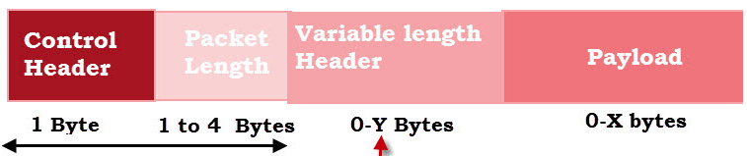
IOT Protocols Example: MQTT Protocol
MQTT is a messaging protocol, designed as lightweight publish/subscribe messaging transport. It is ideal for connecting remote IOT devices with a small client code footprint and minimal network bandwidth.
MQTT is TCP/IP based protocol . First TCP connection established and then data transfer will happen .
Publisher send CONNECT packet to broker with client ID and other options field like persistence flag, username password, keepalive time etc.
Broker receives a CONNECT message,and respond with a CONNACK message after verified client.
Client start publishing the message on topic with packet field like pkt id, topic name, Qos flags, Retain flag and payload.
To receive messages on topics of interest, the client sends a SUBSCRIBE message to the MQTT broker.
Topic Based Filtering: Each message must contain a topic that the broker can use to forward the message to interested clients. The topic consists of one or more topic levels.
Key features:
Lightweight client for resource constrained devices: MQTT clients are very small, require minimal resources,hence can be used on small microcontrollers.
Bandwidth Efficient: MQTT message headers are small(minimal 2 bytes) which optimize network bandwidth.
Reliable Message Delivery: It has 3 defined quality of service levels:
0 - at most once: Best effort delivery. No ack for msg, not stored and retransmitted by recipient . Useful when msg queueing not required or msg loss is accepted and need bandwidth efficient.
1- at least once: guaranteed pkt delivery( It is possible for a message to be sent or delivered multiple times), sender wait for ack for each msg with packet identifier and resend if timeout.
2 - exactly once: ensure pkt delivered only once, with multilevel ack per packets. It is the safest and slowest quality of service level
Support for Unreliable Networks:
MQTT’s support for persistent sessions to reduce time to reconnect the client with the broker.
Broker will keep client’s sessions info, subscribed topics, all msgs of QOS level 1/2 and delivered to client once it reconnect.
Security Enabled:
Encrypt messages using TLS.
Authenticate clients using client ID, username and password.
Scale to Millions of Things: It can scale to connect with millions of IoT devices.
Client2
Msg Sub
Client1
MQTT Broker
Client3
Msg pub
Msg Sub
Msg Sub
Client4
Client
Connect
Broker
CONNACK
Publish
PUBACK
Subscribe
SUBACK
MQTT Protocol Handshake
MQTT Protocol Format

Slide 15
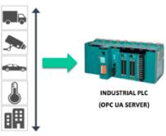
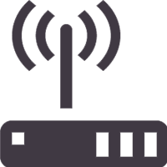
IOT Protocols Example: OPC-UA
OPC UA enable different types of systems(SCADA, HMI etc) and devices(IOT, PLC, Gateway) in Industries to communicate by sending request and response messages between clients and servers or similarly to MQTT via a subscription-publishing model. OPC UA servers define the services they can provide to clients, an object model that can be dynamically discovered by clients and a information model following the data-types defined in the protocol itself.
Some of key features:
Discovery: find the availability of OPC Servers on local PCs and/or networks
Address space: all data is represented hierarchically allowing for simple and complex structures to be discovered and utilized by OPC Clients
On-demand: read and write data/information based on access-permissions
Subscriptions: monitor data/information and report-by-exception when values change based on a client’s criteria
Events: notify important information based on client’s criteria
Methods: clients can execute programs, etc. based on methods defined on the server
OPC UA deployment scenario:
Typical PLCs connect to multiple IOT devices from device/machines
These PLCs act as OPC server and maintain devices/sensors readings get from IOT devices
IOT gateway can connect with these PLCs server as OPC client.
OPC client can directly read values by read request OR can subscribe for variables changes events from server
Control system/SCADA
Central Server
OPC-UA Server
(Industrial PLC)
OPC-UA Client
(Gateway)
OPC-UA Client (Industrial Devices )

Slide 16
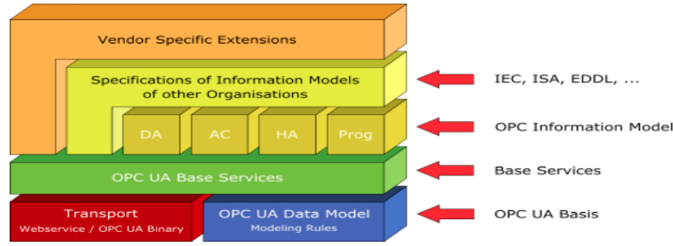
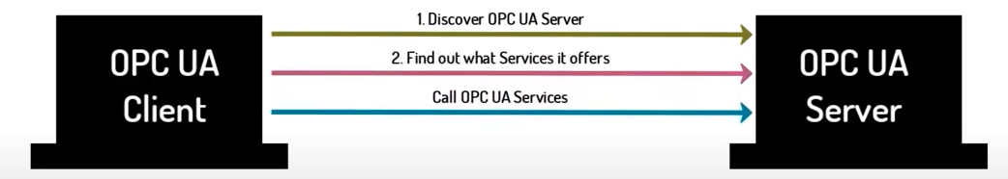
IOT Protocols Example: OPC-UA
Communication: Support client server as well pub-sub communications.
Client-server: OPC UA Server receives requests from the OPC UA Client, processes those requests and sends the response with the results back to the Client
Pub-Sub: For applications that require many-to-many and high frequency access requirements, Publish-Subscribe (PubSub) provides an alternative and optimized communication mechanism for data and event notification.
OPC-UA Services –OPC-UA server provides services by interface between a server as information provider and clients as users of this information.
Information Modelling : OPC UA prebuilt Information model and custom define information model for describe data, devices and relations in a factory/plant.
In OPC-UA, Client can access devices data from Address space with node ID as device ID
Node is basic unit for information model
Each node defined by NodeID:
“ns=uri/id;string=temperature”
Each Node has below attributes:
Node ID
Node attribute
Variables (temparture/pressure etc)
Reference to other relative node

Slide 17
Introduction to existing projects

Slide 18
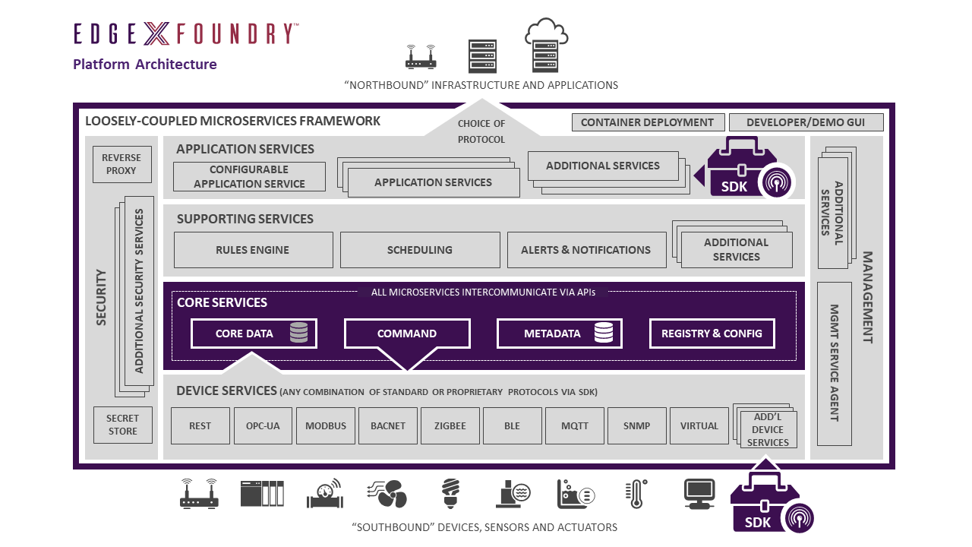
EdgeX Architecture
Loosely coupled microservices with distributed architecture for collect data from different IOT devices, can filter & transform and send to cloud. Data can be store locally for offline support or stream to cloud for live.
It Has supported multiple IOT protocols and Cloud providers. These can quickly extend by provided Device and application service SDKs for new IOT protocols/devices and new North side Cloud/system.
Key features:
Protocol adapters to collect data.
Lightweight Storage for data store offline use cases.
Rule engine, for edge analytics, usages eKuiper.
North exporter for send data to cloud.
Device data modeling, device metadata.
The 4 Service Layers of EdgeX Foundry are as follows:
Core Services Layer
Supporting Services Layer
Application Services Layer
Device Services Layer
The 2 underlying System Services of EdgeX Foundry are as follows:
Security
System Management
EdgeX is mostly written in Go and C

Slide 19
EdgeX Services
Core Services | Core data: a persistence repository and associated management service for data collected from south side objects. Command: a service that facilitates and controls actuation requests from the north side to the south side. Metadata: a repository and associated management service of metadata about the objects that are connected to EdgeX Foundry. Metadata provides the capability to provision new devices and pair them with their owning device services. Registry and Configuration: provides other EdgeX Foundry microservices with information about associated services within EdgeX Foundry and micro services configuration properties.
Supporting service | Rules Engine: Analytics engine, using open source Kuiper . Scheduling: an internal EdgeX “clock” that can kick off operations in any EdgeX service by calling their REST API for specific operation perform like DB cleanup Alerts and Notifications: provides EdgeX services with a central facility to send out an alert or notification. These are notices sent to another system or to a person monitoring the EdgeX instance
Application service | Extract, process/transform and send sensed data from EdgeX to an endpoint like cloud providers (Amazon IoT Hub, Google IoT Core, Azure IoT Hub, IBM Watson IoT…), to MQTT(s) topics, and HTTP(s) REST endpoints.
Device service | Communicates with the devices, sensors, actuators, and other IoT objects through protocols native to each device object. Converts the data produced and communicated by the IoT object into a common EdgeX Foundry data structure, and sends that converted data into the core services layer, and to other micro services in other layers of EdgeX Foundry. Service one or a number of things or devices (sensor, actuator, etc.) at one time.

Slide 20
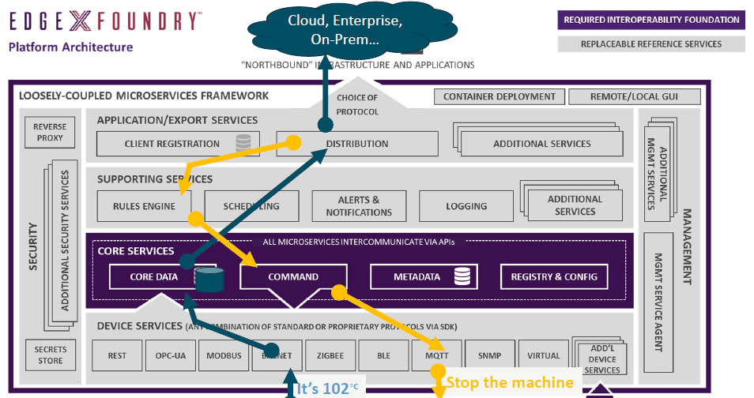
EdgeX data flow
EdgeX data flow
Sensor data is collected by Device Service from the device
Data is passed to the Core Services for local persistence
Data is then passed to Exported Services for transformation, formatting, filtering and can then be sent "north" to enterprise/cloud systems
Data is then available for edge analysis and can trigger device actuation through Command Service

Slide 21
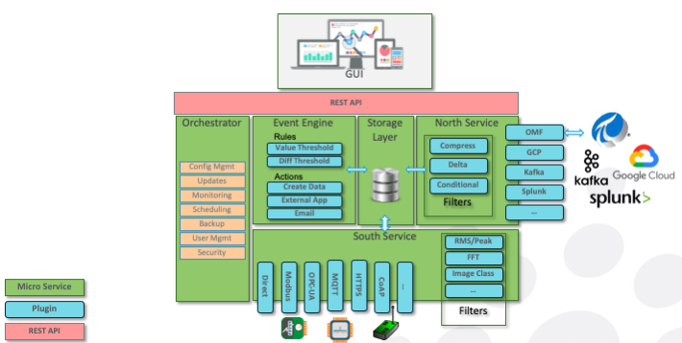
Fledge Architecture
Provides modular microservices architecture including sensor data collection, storage, processing and forwarding to historians, Enterprise systems and Cloud-based services.
Components in blue are plugins. Plugins are light-weight modules that enable Fledge to be extended. There are a variety of types of plugins: south-facing, north-facing, storage engine, filters, event rules and event delivery mechanisms. Plugins can be written in python (for fast development) or C++ (for high performance).
Components in green are microservices. They can co-exist in the same operating environment or they can be distributed across multiple environments.
Fledge is implemented as a collection of microservices which include:
Core services, including security, monitoring, and storage
Data transformation and alerting services
South services: Collect data from sensors and other Fledge systems
North services: Transmit data to historians and other systems
Edge data processing applications
Plugin architecture to extend functionality of system either statically or dynamically
Large list of Plugin supported for south plugin for support number of IOT devices and new Plugin can be easily added by using plugin framework.
Code is in C++ for performance and support development in python as well for easy development
Notes:
https://fledge-iot.readthedocs.io/en/latest/processing_data.html

Slide 22
Fledge Services
Storage Layer | Provides two functions: maintenance of Fledge configuration and run-time state storage/buffering of asset data
Southbound Microservices | Provide bi-directional communication of data and metadata between Edge devices, such as sensors, actuators or PLCs and Fledge
Northbound Microservices | Provide bi-directional communication of data and metadata between the Fledge platform and larger systems located locally or in the cloud.
Filters | Filters are plugins which modify streams of data that flow through Fledge. Can be deployed at ingress (in a South service), or at egress (in a North service). Ingress filters are used to transform or enrich data, and egress filters are used to reduce flow to northbound pipes and infrastructure, i.e. by compressing or reducing data that flows out.
Event Engine | Maintains zero or more rule/action pairs. Each rule subscribes to desired asset data, and evaluates it. If the rule triggers, its associated action is executed. Data Subscriptions: Rules can evaluate every data point for a specified asset Rules: the most basic rule evaluates if values are over/under a specified threshold. Actions: A variety of delivery mechanisms exist to execute a python application, or create arbitrary data, or email/slack/hangout/communicate a message.

Slide 23
Fledge data flow
Collect data from sensors/devices by using south service and protocol plugins
Store data in DB
Filter and transforms data at south and north services
Apply rules and send notifications
Export data by North services with north plugins

Slide 24
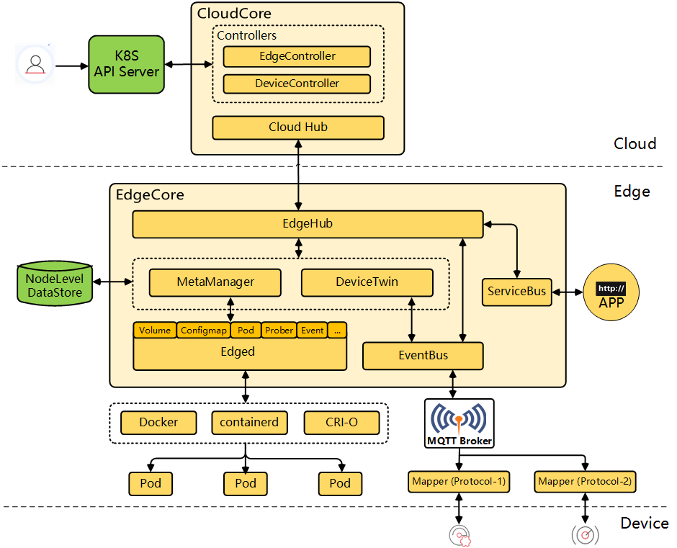
KubeEdge - Open source Public cloud Edge
KubeEdge is an open source system extending native containerized application orchestration and device management to hosts at the Edge.
It is built upon Kubernetes and provides core infrastructure support for networking, application deployment and metadata synchronization between cloud and edge.
Supported IOT stack with device twin, device data modeling, protocol mappers.
Only supported OPC-UA, modBus and Bluetooth protocol.
Notes:
https://kubeedge.io/en/docs/kubeedge/

Slide 25
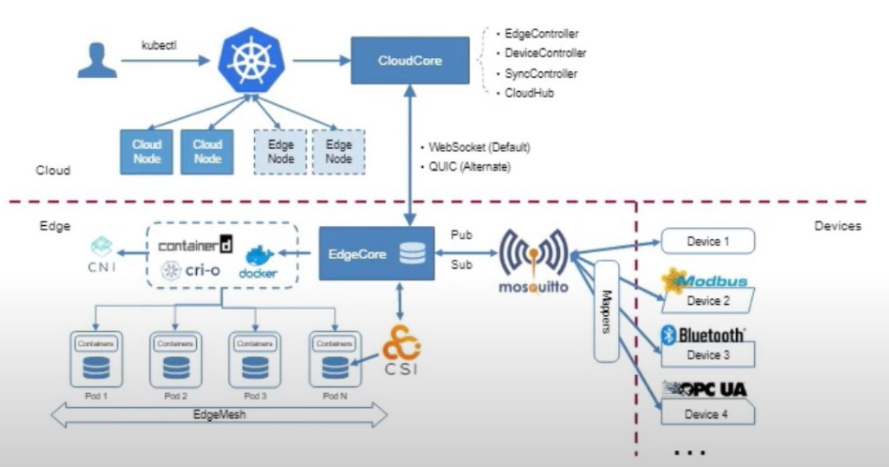
KubeEdge for IOT
Device controller: k8s controller for device data modelling and management. Maintain desired state for devices.
Device Twin: maintain current state of devices in edge site. Sync states with cloud.
Mappers: IOT protocol adapters.
MQTT broker: external or internal, to communicate mappers with Kubeedge

Slide 26
Edge Platforms comparison
IOT Requirements | Fledge | EdgeX | KubeEdge
IOT protocol support | Extensive (many protocol supported, Protocol plugin for extension) | Extensive (many protocol supported, Protocol plugin for extension) | Limited (only ModBus, OPC-UA, Bluetooth)
Device twin | No | YES | YES
Device Control | NO | YES | YES
Offline Support | YES (local storage and export service) | YES (local storage and export service) | NO
Local analytics and close loop action (rule/notification/actuation/alerts) | Partial support (Extensively used for data collection and data processing) | YES | NO
Security (Data) | YES (compression and encryption filters for data security) | YES (compression and encryption filters for data security) | NO
Data filters and transformations | YES | YES | NO

Slide 27
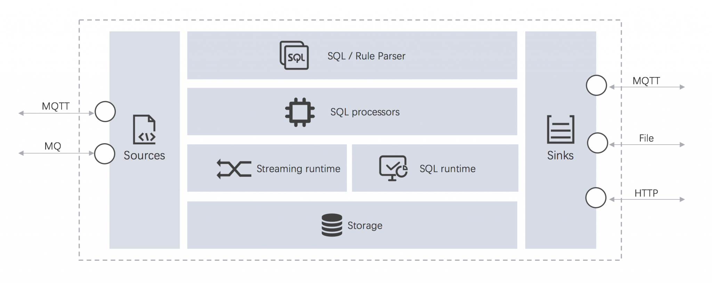
eKuiper
eKuiper is an edge lightweight IoT data analytics / streaming software implemented by Golang
It migrates cloud real-time cloud streaming analytics frameworks such as Apache Spark, Apache Storm and Apache Flink to the edge
eKuiper processing at the edge can reduce system response latency, save network bandwidth and storage costs, and improve system security.

Slide 28
eKuiper - Features
Lightweight
Core server package is only about 4.5M, initial memory footprint is about 10MB
Cross-platform
Industrial PC, Raspberry Pi, industrial gateway, home gateway, MEC edge cloud server
Data analysis support
Support data extract, transform and filter through SQL
Data order, group, aggregation and join
60+ functions, includes mathematical, string, aggregate and hash etc
4 time windows & count window
Highly extensibile Plugin system is provided, and it supports to extend at Source, SQL functions and Sink.
Source: embedded support for MQTT, and provide extension points for sources
Sink: embedded support for MQTT and HTTP, and provide extension points for sinks
UDF functions: embedded support for 60+ functions, and provide extension points for SQL functions
Management
A web based management dashboard for nodes, plugins, streams & rules management
Plugins, streams and rules management through CLI & REST API
Easily be integrate with KubeEdge, K3s and Baetyl, which bases Kubernetes

Slide 29
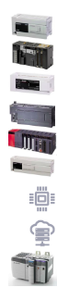
EdgeGallery IOT Profile
Edge 1
Edge 2
MEC APP
Requirements:
Build an IOT platform by integrating opensource tools with below features.
Protocol Layer
Stream Analytics
IOT DB(Time Series)
Multiple profiles
Edge 3
Stream Analytics
IOT DB
Protocol Layer
Cloud
Stream Analytics and IOT DB deployments can be optional.
MEC App is also optional, if not exists, the data output from Fledge/ Kuiper/ TDengine can be configured to stream to cloud to perform central operations.
Protocol Layer
(Fledge)
Stream Analytics (Kuiper)
IOT-DB (TDengine)
MEP App

Slide 30
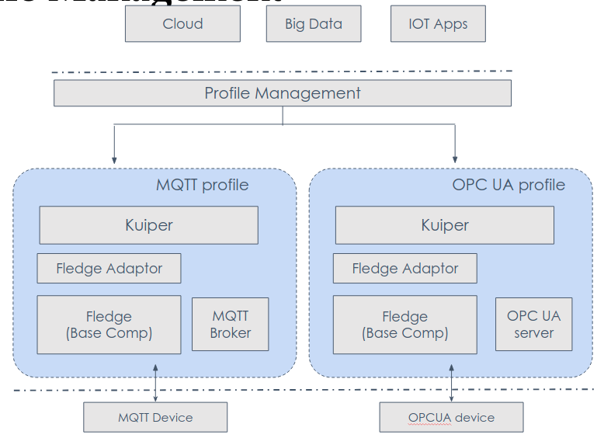
EdgeGallery IOT Profile
Profiles are software stack required to perform a specified task.
Multiple components provided by the platform, can be designed or arranged together to form a profile, which performs a predefined task, such as reading data from IOT devices, process it and store in db.
Using this platform feature, application developers can design or select a profile along with their application.

Slide 31
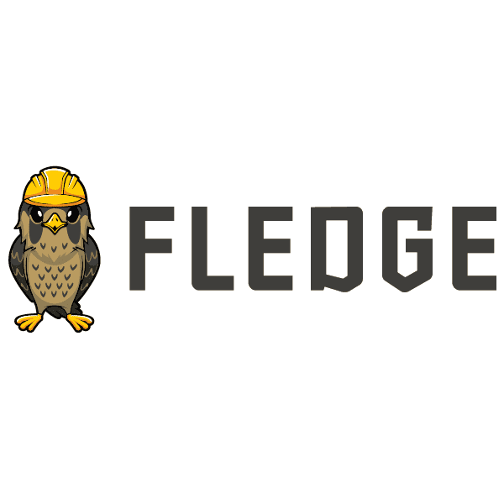

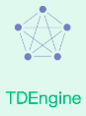
IOT UseCase: Visualization
Remove humidity reading and round temperature value to nearest integer
Store curated data
Reads both Temp & Humidity data
MQTT South Broker
Protocol Stack
MQTT TDEngine Adapter
ETL
Store
MEC App
Fledge
Kuiper
Grafana
Room1/Condition
MQTT BROKER
Temp + Humidity Sensor -1
Temp + Humidity Sensor -1000
Sample E2E Video
https://www.youtube.com/watch?v=yKmW1AFBVcM

Slide 32
Thanks

Slide 33
IOT Requirements
Platform fragmentation: The IoT suffers from platform fragmentation, lack of interoperability and common technical standards. The variety of IoT devices, in terms of both hardware variations and differences in the software running on them, makes the task of developing applications that work consistently between different inconsistent technology ecosystems hard. For example, wireless connectivity for IoT devices can be done using Bluetooth, Zigbee, Z-Wave, LoRa, NB-IoT, Cat M1 as well as completely custom proprietary radios – each with its own advantages and disadvantages; and unique support ecosystem
Software patching: The IoT's amorphous computing nature is also a problem for security, since patches to bugs found in the core operating system often do not reach users of older and lower-price devices.^{[207][208][209]} One set of researchers say that the failure of vendors to support older devices with patches and updates leaves more than 87% of active Android devices vulnerable.
Data storage: huge data generated by IOT devices. A challenge for producers of IoT applications is to clean, process and interpret the vast amount of data which is gathered by the sensors.
Security: Security is the biggest concern in adopting Internet of things technology,^{[229]} with concerns that rapid development is happening without appropriate consideration of the profound security challenges involved^{[230]} and the regulatory changes that might be necessary. These concerns include using weak authentication, forgetting to change default credentials, unencrypted messages sent between devices, SQL injections, Man-in-the-middle attacks, and poor handling of security updates.^{[234][235]} However, many IoT devices have severe operational limitations on the computational power available to them. These constraints often make them unable to directly use basic security measures such as implementing firewalls or using strong cryptosystems to encrypt their communications with other devices^{[236]} - and the low price and consumer focus of many devices makes a robust security patching system uncommon

Slide 34
IOT Introduction: Requirements
Consumer IOT
Characteristics
Protocol Requirement
Low Power | IOT devices are resource constrained devices and need to be always on most of cases. They expect a long life of battery as well.
Lower Footprints | Device memory size will be very low, hence all software stack including protocol should be minimal.
Low Price | IoT device are expected to be of low price with minimal hardware/software capability
Light Protocol Stack | Protocol clients libs/stack runs on IOT devices required to be lightweight so they should be simple. For example CoAP protocol which is used by IOT, is simpler version of HTTP which is complex.
Low Network Overhead | Some devices may need to send only few bytes data, so IOT protocol should be with minimal headers required for such communication.
Typically Consumer IOT doesn’t demand for very low latency.
Also it doesn’t requires M2M communications and Man controlling machine is expected.
Typically used data link protocols as WIFI & Bluetooth. Vendor specific application protocols will be used.
Edge requirement for these scenarios are not much and is not a major focus area for Edge Computing Platforms like EdgeGallery, EdgeX, Fledge
In LF Edge “HomeEdge” is only project working for Home Automation
https://www.lfedge.org/projects/homeedge/

Slide 35
IOT Device Characteristics and Protocol Requirements
Low Power | IOT devices are resource constrained devices and need to be always on most of cases. They expect a long life of battery as well.
Lower Footprints | Device memory size will be very low, hence all software stack including protocol should be minimal.
Multiple Protocol | Different devices use different protocol for communications. Some of characteristics of communications are like low power, long range, short range, wide area, personal area, local area, always on, rarely triggered, one/two way channels.
Low Network Overhead | Some devices may need to send only few bytes data, so IOT protocol should be with minimal headers required for such communication.
Light Protocol Stack | Protocol clients libs/stack runs on IOT devices required to be lightweight so they should be simple. For example CoAP protocol which is used by IOT, is simpler version of HTTP which is complex.
Platform fragmentation | Due to number of protocols, difference in hardware/software stack there are fragmentation of platforms. For example, wireless connectivity for IoT devices can be done using Bluetooth, Zigbee, Z-Wave, LoRa, NB-IoT, Cat M1 as well as completely custom proprietary radios – each with its own advantages and disadvantages; and unique support ecosystem. Interoperability is challenge in such environment.
Software updates/ security patching | Low price devices provided by vendors, may not support patching for bugs and software upgrade easily. There is a need to centrally able to apply patch on such devices..
Security | Non standards, low price, resource constraints IOT devices Security concerns include using weak authentication, forgetting to change default credentials, unencrypted messages sent between devices, SQL injections, Man-in-the-middle attacks, and poor handling of security updates.

Slide 36
IOT Protocols: MQTT
publisher has the possibility to define the quality of its message:
QoS0 (At most once): The least reliable mode but also the fastest. The publication is sent but confirmation is not received.
QoS1 (At least once): Ensures that the message is delivered at least once, but duplicates may be received.
QoS2 (Exactly once): The most reliable mode while the most bandwidth-consuming. Duplicates are controlled to ensure that the message is delivered only once.
Having found wide application in such IoT devices as electric meters, vehicles, detectors, and industrial or sanitary equipment, MQTT responds well to the following needs:
Minimum bandwidth use
Operation over wireless networks
Low energy consumption
Good reliability if necessary
Little processing and memory resources
However, despite its wide adoption, MQTT doesn’t support a well-defined data representation and device management structure model, which renders the implementation of its data management and device management capabilities entirely platform- or vendor-specific.

Slide 37
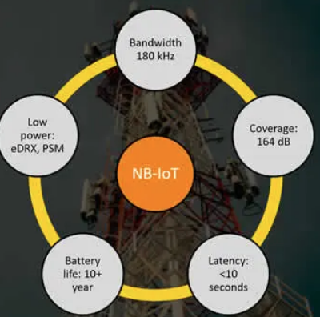
NB-IOT Details
Narrowband IoT or NB-IoT () is a wireless communication standard for the Internet of Things for
NB-IoT belongs to the category of low-power wide-area networks (LPWAN), enabling to connect devices that need small amounts of data, low bandwidth, and long battery life.
This makes it suitable for a variety of applications and use cases for IoT.
Notes:
https://www.i-scoop.eu/internet-of-things-iot/lpwan/nb-iot-narrowband-iot/

